Slide 1
W4111 – Introduction to Databases Section 003, V03, Fall 2024 Lecture 4: ER(3), Relational(3), SQL(3)
© Donald F. Ferguson, 2024

Slide 2
W4111 – Introduction to Databases Section 003, V03, Fall 2024 Lecture 4: ER(3), Relational(3), SQL(3)
We will start in a few minutes.
© Donald F. Ferguson, 2024

Slide 3

Today’s Contents
3 | COMS W4111_003_2024_3: Lecture 4: ER(3), Relational(3), SQL(3) © Donald F. Ferguson, 2024

Slide 4
Contents
Introduction and course updates.
ER Modeling (3).
Relational model and algebra (3).
SQL (3).
Homework and projects.

Slide 5
Introduction and course updates
5 | COMS W4111_003_2024_3: Lecture 4: ER(3), Relational(3), SQL(3) © Donald F. Ferguson, 2024

Slide 6
Course Updates

Slide 7
ER Modeling
7 | COMS W4111_003_2024_3: Lecture 4: ER(3), Relational(3), SQL(3) © Donald F. Ferguson, 2024

Slide 8
Let’s Examine and Do Some Examples
Introduction
8 | COMS W4111_003_2024_3: Lecture 4: ER(3), Relational(3), SQL(3) © Donald F. Ferguson, 2024

Slide 9
Relational Model
9 | COMS W4111_003_2024_3: Lecture 4: ER(3), Relational(3), SQL(3) © Donald F. Ferguson, 2024

Slide 10
Equivalent Queries
There is more than one way to write a query in relational algebra.
Example: Find information about courses taught by instructors in the Physics department with salary greater than 90,000
Query 1
σ _{dept_name=“Physics”} ∧ _{salary > 90,000} (instructor)
Query 2
σ _{dept_name=“Physics”} (σ _{salary > 90.000} (instructor))
The two queries are not identical; they are, however, equivalent -- they give the same result on any database.

Slide 11
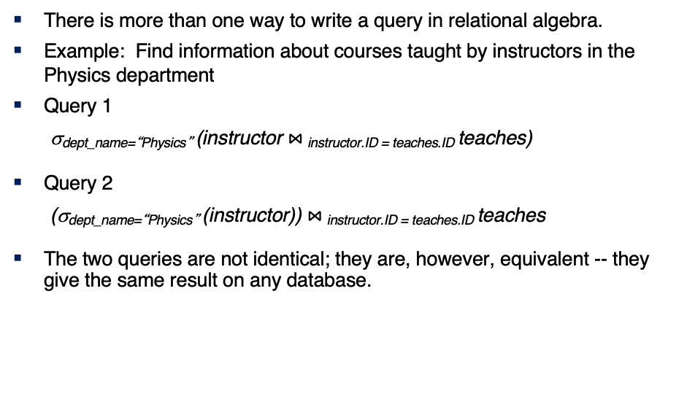
Equivalent Queries
There is more than one way to write a query in relational algebra.
Example: Find information about courses taught by instructors in the Physics department
Query 1
σ_{dept_name=“Physics”} (instructor $⋈_{ }$_{instructor.ID = teaches.ID} teaches)
Query 2
(σ_{dept_name=“Physics”} (instructor)) $⋈_{ }$_{instructor.ID = teaches.ID} teaches
The two queries are not identical; they are, however, equivalent -- they give the same result on any database.

Slide 12
What are all those other Symbols?
Some of the operators are useful and “common,” but not always considered part of the core algebra.
Some of these are pretty obscure
Division
Anti-Join
Left semi-join
Right semi-join
Most SQL engines do not support them.
You can implement them using combinations of JOIN, SELECT, WHERE, ... ...
But, I cannot every remember using them in applications I have developed.
Outer JOIN is very useful, but less common. We will cover.
There are also some “patterns” or “terms”
Equijoin
Non-equi join
Natural join
Theta join
... ...
I may ask you to define these terms on some exams or the obscure operatorsbecause they may be common internships/job interview questions.
τ order by
γ group by
¬ negation
÷ set division
⨝ natural join, theta-join
⟕ left outer join
⟖ right outer join
⟗ full outer join
⋉ left semi join
⋊ right semi join
▷ anti-join

Slide 13
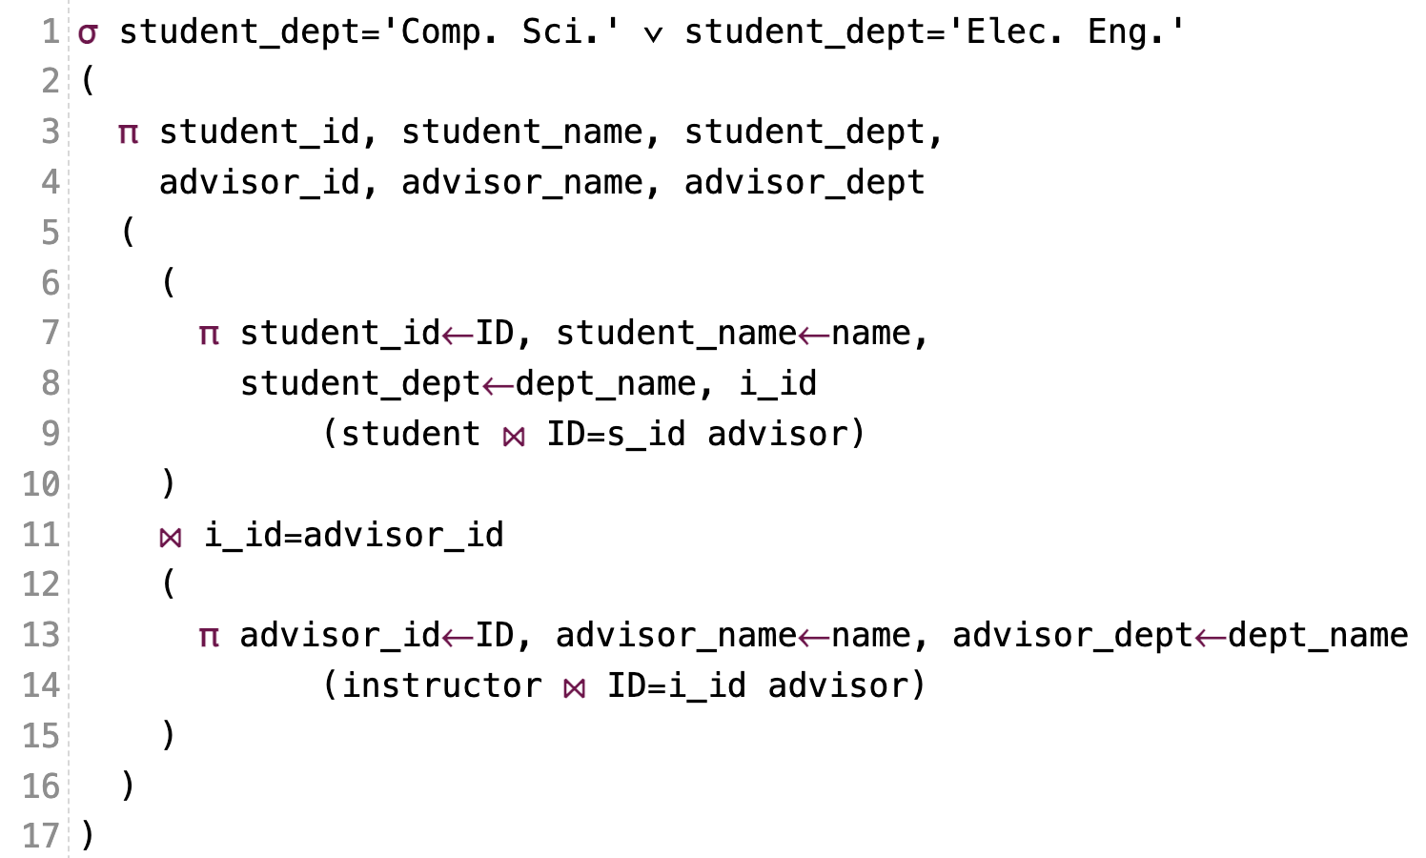
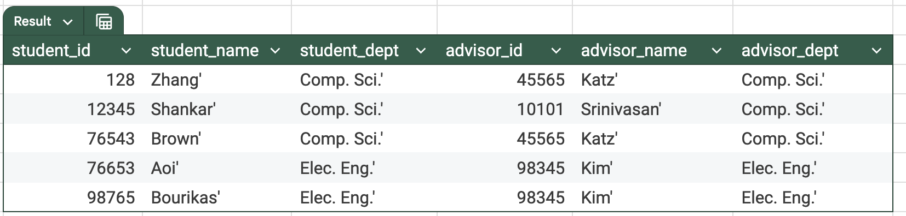
What are all those other Symbols?
τ order by
γ group by
¬ negation
÷ set division
⨝ natural join, theta-join
⟕ left outer join
⟖ right outer join
⟗ full outer join
⋉ left semi join
⋊ right semi join
▷ anti-join

Slide 14
One Way to Think About Joins

Slide 15
Thinking about JOINs
Some terms:
Natural Join
Equality of A and B columns
With the same name.
Equijoin
Explicitly specify columns that must have the same value.
A.x=B.z AND A.q=B.w
Theta Join: Arbitrary predicate.
Inner Join
JOIN “matches” rows in A and B.
Result contains ONLY the matched pairs.
What I want is:
All the rows that matched.
And the rows from A that did not match?
OUTER JOIN (⟖, ⟕)

Slide 16
Do Some Joins
prereq is interesting
All courses with prereqs.
All courses and prereqs even if it does not have a prereq.
All courses and ones that are prereqs
Courses that do not have prereqs
Etc.
See notebook with examples.

Slide 17
Some Examples
A course and its prerequisites
π course_id←course.course_id,
course_title←course.title,
prerequisite_id←prereq.prereq_id,
prerequisite_title←p.course_id
(
(course ⨝ prereq)
⨝ prereq.prereq_id=p.course_id
ρ p(course))
Join course and prereq to get
course info
prereq_id
Join with
course using prereq_id
To get the prereq info
But,
course.course_id is ambiguous
Because the table appears twice.
So, I have to “alias” the second use.
Also, note the use of renaming in the project for column names.

Slide 18
Some Examples
Courses-prerequisites and courses without prereqs.
τ prerequisite_id
(π course_id←course.course_id,
course_title←course.title,
prerequisite_id←prereq.prereq_id,
prerequisite_title←p.course_id
(
(course ⟕ prereq)
⟕ prereq.prereq_id=p.course_id
ρ p(course))
)

Slide 19
Some Examples
Courses that are not prerequisites
τ prereq_course_id
(
π prereq_course_id←prereq.course_id,
course_id←course.course_id,
course_title←course.title
(
prereq ⟖ prereq_id=course.course_id course
)
)

Slide 20
Relational Algebra
We will do more examples in lectures and HW assignments.
The language is interesting but can be tedious and confusing.
Useful in some advanced scenarios:
Designing query languages for new databases and data models.
Understanding how DBMS implement query processing and optimization.
Also cover because it does come up in some advanced courses, and may come up in job interviews.
You will be able to use a “cheat sheet” on exams. We will focus on “did you know what to do” and not “did you get the syntax completely correct.”

Slide 21
Codd’s 12 Rules NULL
Introduction
21 | COMS W4111_003_2024_3: Lecture 4: ER(3), Relational(3), SQL(3) © Donald F. Ferguson, 2024

Slide 22
Codd’s 12 Rules
Rule 4: Active Online Catalog
The structure description of the entire database must be stored in an online catalog, known as data dictionary, which can be accessed by authorized users. Users can use the same query language to access the catalog which they use to access the database itself.
Rule 5: Comprehensive Data Sub-Language Rule
A database can only be accessed using a language having linear syntax that supports data definition, data manipulation, and transaction management operations. This language can be used directly or by means of some application. If the database allows access to data without any help of this language, then it is considered as a violation.
Rule 6: View Updating Rule
All the views of a database, which can theoretically be updated, must also be updatable by the system.
Rule 1: Information Rule
The data stored in a database, may it be user data or metadata, must be a value of some table cell. Everything in a database must be stored in a table format.
Rule 2: Guaranteed Access Rule
Every single data element (value) is guaranteed to be accessible logically with a combination of table-name, primary-key (row value), and attribute-name (column value). No other means, such as pointers, can be used to access data.
Rule 3: Systematic Treatment of NULL Values
The NULL values in a database must be given a systematic and uniform treatment. This is a very important rule because a NULL can be interpreted as one the following − data is missing, data is not known, or data is not applicable.

Slide 23
Codd’s 12 Rules
Rule 10: Integrity Independence
A database must be independent of the application that uses it. All its integrity constraints can be independently modified without the need of any change in the application. This rule makes a database independent of the front-end application and its interface.
Rule 11: Distribution Independence
The end-user must not be able to see that the data is distributed over various locations. Users should always get the impression that the data is located at one site only. This rule has been regarded as the foundation of distributed database systems.
Rule 12: Non-Subversion Rule
If a system has an interface that provides access to low-level records, then the interface must not be able to subvert the system and bypass security and integrity constraints.
Rule 7: High-Level Insert, Update, and Delete Rule
A database must support high-level insertion, updation, and deletion. This must not be limited to a single row, that is, it must also support union, intersection and minus operations to yield sets of data records.
Rule 8: Physical Data Independence
The data stored in a database must be independent of the applications that access the database. Any change in the physical structure of a database must not have any impact on how the data is being accessed by external applications.
Rule 9: Logical Data Independence
The logical data in a database must be independent of its user’s view (application). Any change in logical data must not affect the applications using it. For example, if two tables are merged or one is split into two different tables, there should be no impact or change on the user application. This is one of the most difficult rule to apply.

Slide 24
Codd’s 12 Rules
Rule 3: Systematic treatment of null values:
“Null values (distinct from the empty character string or a string of blank characters and distinct from zero or any other number) are supported in fully relational DBMS for representing missing information and inapplicable information in a systematic way, independent of data type.”
Sometimes programmers and database designers are tempted to use “special values” to indicate unknow, missing or inapplicable values.
String: “”, “NA”, “UNKNOWN”, ...
Numbers: -1, 0, -9999
Indicators can cause confusion because you have to carefully code some SQL statements to the specific, varying choices programmers made.

Slide 25
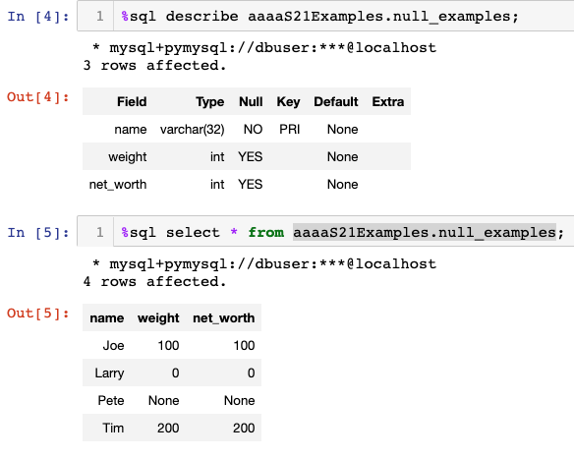
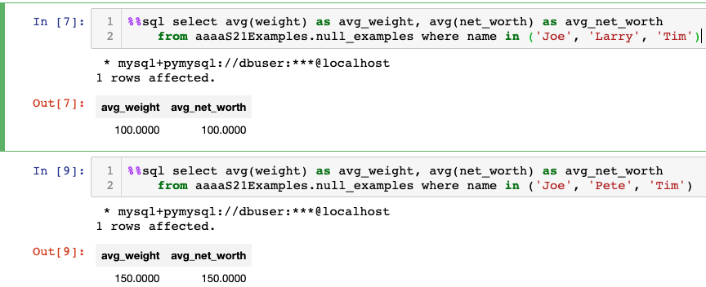
NULL and Correct Answers
Without NULL, to get a correct answer:
I must understand the domain to determine “unknown” values or know what choice a developer made.
Explicitly include “where weight != 0” in all statements.
And this varies from column to column, table to table, schema to schema, etc.

Slide 26
Null Values
It is possible for tuples to have a null value, denoted by null, for some of their attributes
null signifies an unknown value or that a value does not exist.
The result of any arithmetic expression involving null is null
Example: 5 + null returns null
The predicate is null can be used to check for null values.
Example: Find all instructors whose salary is null.
select name from instructor where salary is null
The predicate is not null succeeds if the value on which it is applied is not null.
Note:
NULL is an extremely important concept.
You will find it hard to understand for a while.
Note that RelaX uses “=“ for NULL despite the fact that SQL does not.

Slide 27
Null Values (Cont.)
SQL treats as unknown the result of any comparison involving a null value (other than predicates is null and is not null).
Example: 5 < null or null <> null or null = null
The predicate in a where clause can involve Boolean operations (and, or, not); thus the definitions of the Boolean operations need to be extended to deal with the value unknown.
and : (true and unknown) = unknown, (false and unknown) = false, (unknown and unknown) = unknown
or: (unknown or true) = true, (unknown or false) = unknown (unknown or unknown) = unknown
Result of where clause predicate is treated as false if it evaluates to unknown

Slide 28
SQL
28 | COMS W4111_003_2024_3: Lecture 4: ER(3), Relational(3), SQL(3) © Donald F. Ferguson, 2024

Slide 29
Aggregate Functions
Introduction
29 | COMS W4111_003_2024_3: Lecture 4: ER(3), Relational(3), SQL(3) © Donald F. Ferguson, 2024

Slide 30
Aggregate Functions
These functions operate on the multiset of values of a column of a relation, and return a value
avg: average value min: minimum value max: maximum value sum: sum of values count: number of values
Note: Some database implementations have additional aggregate functions.

Slide 31
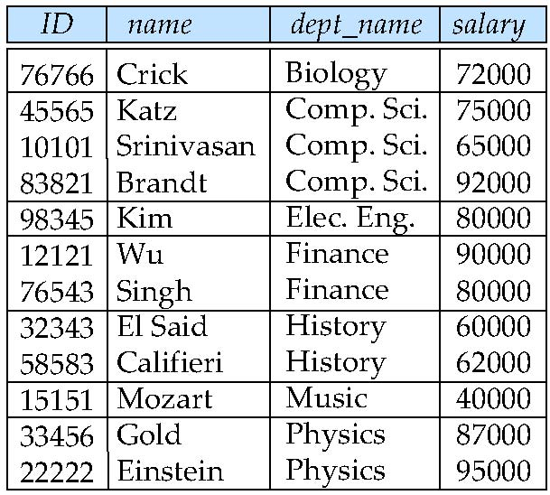
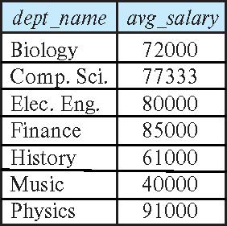
Aggregate Functions – Group By
Find the average salary of instructors in each department
select dept_name, avg (salary) as avg_salary from instructor group by dept_name;

Slide 32
Another View
GROUP BY column list
Forms partitions containing multiple rows.
All rows in a partition have the same values for the GROUP BY columns.
The aggregate functions
Merge the non-group by attributes, which may differ from row to row.
Into a single value for each attribute.
The result is one row per distinct set of GROUP BY values.
There may be multiple non-GROUP BY COLUMNS, each with its own aggregate function.
You can use HAVING in place of WHERE on the GROUP BY result.

Slide 33
Aggregate Functions Examples
Find the average salary of instructors in the Computer Science department
select avg (salary) from instructor where dept_name= 'Comp. Sci.';
Find the total number of instructors who teach a course in the Spring 2018 semester
select count (distinct ID) from teaches where semester = 'Spring' and year = 2018;
Find the number of tuples in the course relation
select count (*) from course;

Slide 34
Aggregation (Cont.)
Attributes in select clause outside of aggregate functions must appear in group by list
/* erroneous query */ select dept_name, ID, avg (salary) from instructor group by dept_name;

Slide 35
Aggregate Functions – Having Clause
Find the names and average salaries of all departments whose average salary is greater than 42000
Note: predicates in the having clause are applied after the formation of groups whereas predicates in the where clause are applied before forming groups
select dept_name, avg (salary) as avg_salary
from instructor
group by dept_name
having avg (salary) > 42000;

Slide 36
JOINs
Introduction
36 | COMS W4111_003_2024_3: Lecture 4: ER(3), Relational(3), SQL(3) © Donald F. Ferguson, 2024

Slide 37
One Way to Think About Joins

Slide 38
Outer Join
An extension of the join operation that avoids loss of information.
Computes the join and then adds tuples form one relation that does not match tuples in the other relation to the result of the join.
Uses null values.
Three forms of outer join:
left outer join
right outer join
full outer join

Slide 39
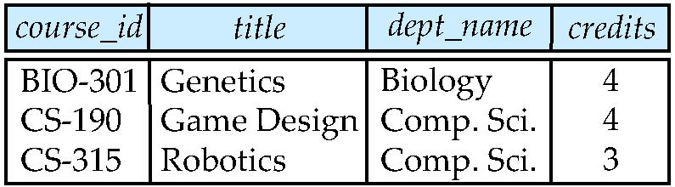
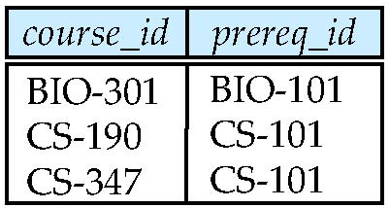
Outer Join Examples
Relation course
Relation prereq
Observe that
course information is missing CS-437
prereq information is missing CS-315
x

Slide 40
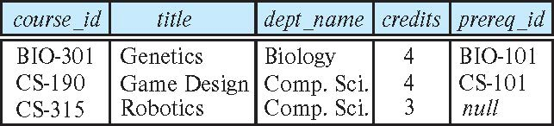
Left Outer Join
course natural left outer join prereq
In relational algebra: course ⟕ prereq

Slide 41
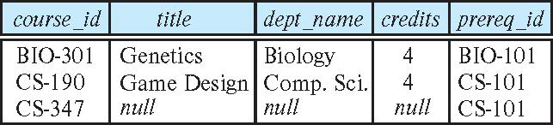
Right Outer Join
course natural right outer join prereq
In relational algebra: course ⟖ prereq

Slide 42
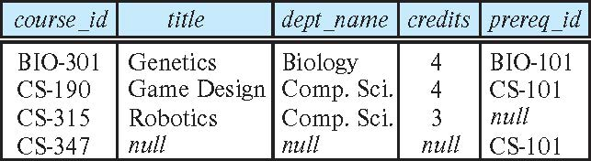
Full Outer Join
course natural full outer join prereq
In relational algebra: course ⟗ prereq

Slide 43
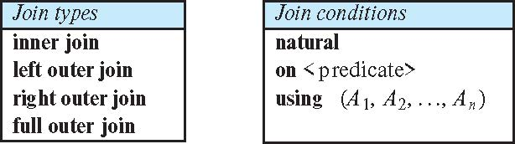
Joined Types and Conditions
Join operations take two relations and return as a result another relation.
These additional operations are typically used as subquery expressions in the from clause
Join condition – defines which tuples in the two relations match.
Join type – defines how tuples in each relation that do not match any tuple in the other relation (based on the join condition) are treated.

Slide 44
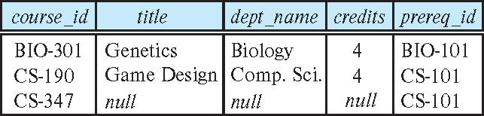
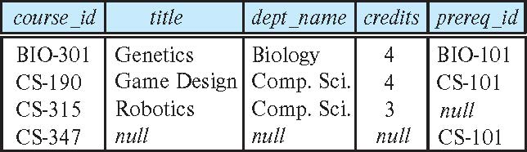
Joined Relations – Examples
course natural right outer join prereq
course full outer join prereq using (course_id)

Slide 45
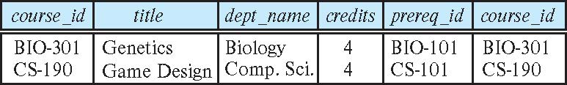
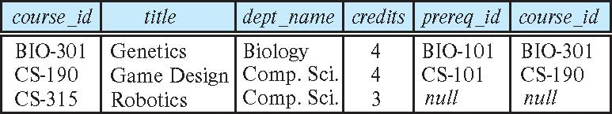
Joined Relations – Examples
course inner join prereq on course.course_id = prereq.course_id
What is the difference between the above, and a natural join?
course left outer join prereq on course.course_id = prereq.course_id

Slide 46
Joined Relations – Examples
course natural right outer join prereq
course full outer join prereq using (course_id)

Slide 47
Let’s Do Some Examples
JOINs using Classic Models
See ./join-and-aggregate.sql
Introduction
47 | COMS W4111_003_2024_3: Lecture 4: ER(3), Relational(3), SQL(3) © Donald F. Ferguson, 2024

Slide 48
Set Operations
Introduction
48 | COMS W4111_003_2024_3: Lecture 4: ER(3), Relational(3), SQL(3) © Donald F. Ferguson, 2024

Slide 49
Set Operations
Find courses that ran in Fall 2017 or in Spring 2018
(select course_id from section where sem = 'Fall' and year = 2017) union (select course_id from section where sem = 'Spring' and year = 2018)
Find courses that ran in Fall 2017 and in Spring 2018
(select course_id from section where sem = 'Fall' and year = 2017) intersect (select course_id from section where sem = 'Spring' and year = 2018)
Find courses that ran in Fall 2017 but not in Spring 2018
(select course_id from section where sem = 'Fall' and year = 2017) except (select course_id from section where sem = 'Spring' and year = 2018)
Note:
Show in Relax calculator.
Not all databases support INTERSECT and EXCEPT
We will see how to handle below.

Slide 50
Set Operations (Cont.)
Set operations union, intersect, and except
Each of the above operations automatically eliminates duplicates
To retain all duplicates use the
union all,
intersect all
except all.

Slide 51
Subqueries Concepts and Examples (Including Set Membership)
Introduction
51 | COMS W4111_003_2024_3: Lecture 4: ER(3), Relational(3), SQL(3) © Donald F. Ferguson, 2024

Slide 52
Nested Subqueries
SQL provides a mechanism for the nesting of subqueries. A subquery is a select-from-where expression that is nested within another query.
The nesting can be done in the following SQL query select A₁, A₂, ..., A_{n} from r₁, r₂, ..., r_{m} where P
as follows:
From clause: r_{i} can be replaced by any valid subquery
Where clause: P can be replaced with an expression of the form:
B <operation> (subquery)
B is an attribute and <operation> to be defined later.
Select clause:
A_{i} can be replaced be a subquery that generates a single value.
Note:
This is a little cryptic.
I think I know what they mean.
There are some operations we will see later in the material, e.g IN, EXISTS, ... ...

Slide 53
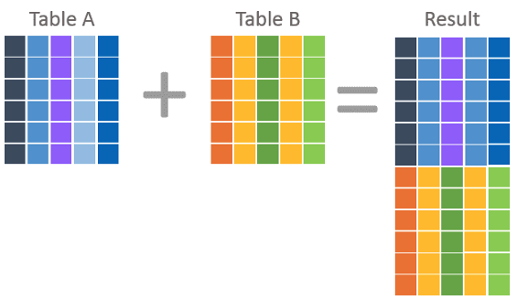
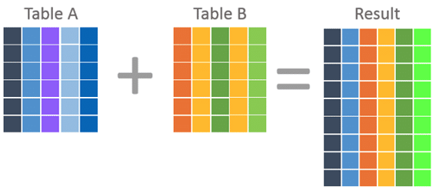
Nested Subquery
The slides that come with the book have surprisingly little material on nested subqueries.
The concept is:
Extremely important.
Students often find subqueries more confusing than joins.
The relationship/difference of subqueries to joins is often, initial unclear.
We have seen:
Union sort of puts a table on top of a table.
Join puts tables sort of puts tables side-by-side.
Subquery enables one query to call another during execution like a subfunction.

Slide 54
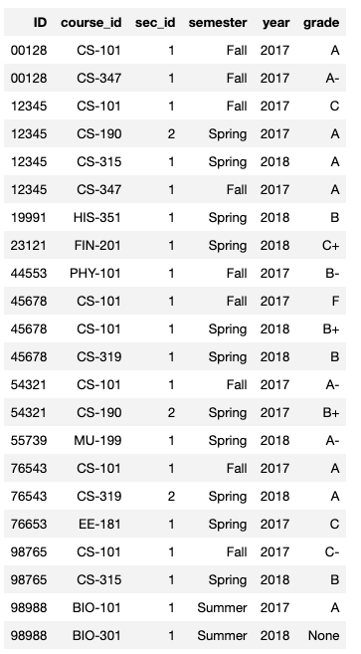
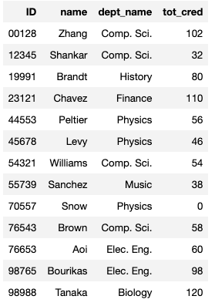
Consider Some Tables
Student
Takes

Slide 55
Consider a Subquery Tables
select *, (select name from student where student.id=takes.id) as name from takes;
Takes
Assume I wrote a function find_student_name(x)
Input is an x
Loops through all students and returns students with student.ID = x.
The query with a subquery above is like:
result = []
For t in takes:
new_r = t + find_student_name(t.id)
result.append(new_r)
Student

Slide 56
Nested Subqueries
SQL provides a mechanism for the nesting of subqueries. A subquery is a select-from-where expression that is nested within another query.
The nesting can be done in the following SQL query select A₁, A₂, ..., A_{n} from r₁, r₂, ..., r_{m} where P
as follows:
From clause: r_{i} can be replaced by any valid subquery
Where clause: P can be replaced with an expression of the form:
B <operation> (subquery)
B is an attribute and <operation> to be defined later.
Select clause:
A_{i} can be replaced be a subquery that generates a single value.
Note: Subquery MUST return
A single scalar if in the SELECT.
A Table if in the FROM.
If in the WHERE:
Either a scalar or a table.
Depending on the operation.

Slide 57
Set Membership

Slide 58
Set Membership
Find courses offered in Fall 2017 and in Spring 2018
Find courses offered in Fall 2017 but not in Spring 2018
select distinct course_id
from section
where semester = 'Fall' and year= 2017 and course_id in (select course_id
from section
where semester = 'Spring' and year= 2018);
select distinct course_id
from section
where semester = 'Fall' and year= 2017 and course_id not in (select course_id
from section
where semester = 'Spring' and year= 2018);

Slide 59
Set Membership (Cont.)
Name all instructors whose name is neither “Mozart” nor Einstein”
select distinct name
from instructor
where name not in ('Mozart', 'Einstein')
Find the total number of (distinct) students who have taken course sections taught by the instructor with ID 10101
Note: Above query can be written in a much simpler manner. The formulation above is simply to illustrate SQL features
select count (distinct ID)
from takes
where (course_id, sec_id, semester, year) in (select course_id, sec_id, semester, year
from teaches
where teaches.ID= 10101);

Slide 60
Set Comparison

Slide 61
Set Comparison – “some” Clause
Find names of instructors with salary greater than that of some (at least one) instructor in the Biology department.
Same query using > some clause
select distinct T.name
from instructor as T, instructor as S
where T.salary > S.salary and S.dept name = 'Biology';
select name
from instructor
where salary > some (select salary
from instructor
where dept name = 'Biology');

Slide 62
Definition of “some” Clause
F <comp> some r ⇔ ∃ t ∈ r such that (F <comp> t ) Where <comp> can be: <, ≤, >, =, ≠
0
(5 < some
5
) = true
(read: 5 < some tuple in the relation)
6
0
(5 < some
5
) = false
0
(5 = some
) = true
5
0
(5 ≠ some
5
) = true (since 0 ≠ 5)
(= some) ≡ in
However, (≠ some) ≡ not in

Slide 63
Set Comparison – “all” Clause
Find the names of all instructors whose salary is greater than the salary of all instructors in the Biology department.
select name
from instructor
where salary > all (select salary
from instructor
where dept name = 'Biology');

Slide 64
Definition of “all” Clause
F <comp> all r ⇔ ∀ t ∈ r (F <comp> t)
0
(5 < all
5
) = false
6
6
(5 < all
) = true
10
4
(5 = all
) = false
5
4
(5 ≠ all
) = true (since 5 ≠ 4 and 5 ≠ 6)
6
(≠ all) ≡ not in
However, (= all) ≡ in

Slide 65
Test for Empty Relations
The exists construct returns the value true if the argument subquery is nonempty.
exists r ⇔ r ≠ Ø
not exists r ⇔ r = Ø

Slide 66
Use of “exists” Clause
Yet another way of specifying the query “Find all courses taught in both the Fall 2017 semester and in the Spring 2018 semester”
select course_id from section as S where semester = 'Fall' and year = 2017 and exists (select * from section as T where semester = 'Spring' and year= 2018 and S.course_id = T.course_id);
Correlation name – variable S in the outer query
Correlated subquery – the inner query

Slide 67
Use of “not exists” Clause
Find all students who have taken all courses offered in the Biology department.
Note that X – Y = Ø ⇔ X ⊆ Y
Note: Cannot write this query using = all and its variants
select distinct S.ID, S.name
from student as S
where not exists ( (select course_id
from course
where dept_name = 'Biology')
except
(select T.course_id
from takes as T
where S.ID = T.ID));
First nested query lists all courses offered in Biology
Second nested query lists all courses a particular student took

Slide 68
Test for Absence of Duplicate Tuples
The unique construct tests whether a subquery has any duplicate tuples in its result.
The unique construct evaluates to “true” if a given subquery contains no duplicates .
Find all courses that were offered at most once in 2017
select T.course_id from course as T where unique ( select R.course_id from section as R where T.course_id= R.course_id and R.year = 2017);

Slide 69
Subqueries in the From Clause

Slide 70
Subqueries in the Form Clause
SQL allows a subquery expression to be used in the from clause
Find the average instructors’ salaries of those departments where the average salary is greater than $42,000.”
select dept_name, avg_salary from ( select dept_name, avg (salary) as avg_salary from instructor group by dept_name) where avg_salary > 42000;
Note that we do not need to use the having clause
Another way to write above query
select dept_name, avg_salary from ( select dept_name, avg (salary) from instructor group by dept_name)
as dept_avg (dept_name, avg_salary)
where avg_salary > 42000;

Slide 71
With Clause
The with clause provides a way of defining a temporary relation whose definition is available only to the query in which the with clause occurs.
Find all departments with the maximum budget with max_budget (value) as (select max(budget) from department) select department.name from department, max_budget where department.budget = max_budget.value;

Slide 72
Complex Queries using With Clause
Find all departments where the total salary is greater than the average of the total salary at all departments
with dept _total (dept_name, value) as
(select dept_name, sum(salary)
from instructor
group by dept_name),
dept_total_avg(value) as
(select avg(value)
from dept_total)
select dept_name
from dept_total, dept_total_avg
where dept_total.value > dept_total_avg.value;

Slide 73
Scalar Subquery
Scalar subquery is one which is used where a single value is expected
List all departments along with the number of instructors in each department
select dept_name, ( select count(*) from instructor where department.dept_name = instructor.dept_name) as num_instructors from department;
Runtime error if subquery returns more than one result tuple

Slide 74
Do Some Examples if not too Tired or Bored
Introduction
74 | COMS W4111_003_2024_3: Lecture 4: ER(3), Relational(3), SQL(3) © Donald F. Ferguson, 2024

Slide 75
Random Thoughts on Projects
75 | COMS W4111_003_2024_3: Lecture 4: ER(3), Relational(3), SQL(3) © Donald F. Ferguson, 2024

Slide 76
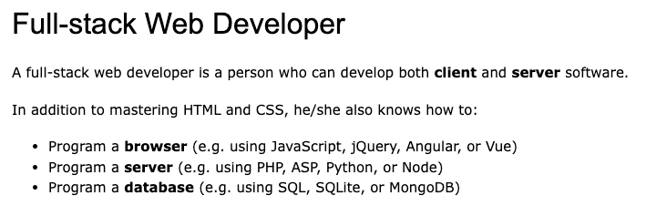
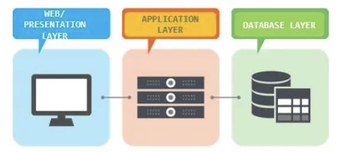
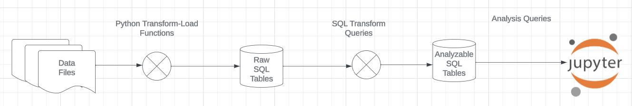
Projects
The programming track will implement a simple, full stack web application.
The non-programming track will implement a data engineering and visualization process in a Jupyter notebook.

Slide 77
Approach
You will find or generate an interesting dataset.
I will provide templates and get started code for the
Full stack project
Data project
Over the semester, starting with HW2, you will start to flesh out.
A lot of my examples will use IMDB and Game of Thrones, but this data is huge.
So, I used ChatCPT to generate some Lord of the Rings Data.
Scroll through ChatGPT history.
Show project-get-started.ipynb
You can do something similar or find some interesting data.

